Slide 1
The Tribulation Saints
Revelation 7

Slide 2
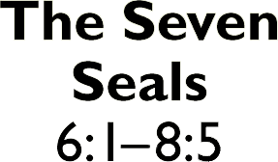
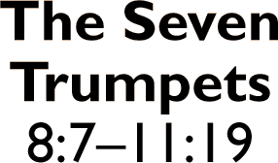
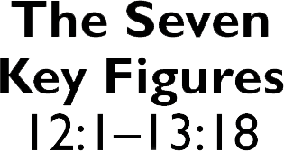
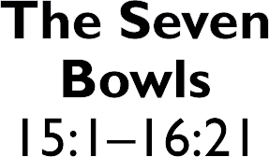
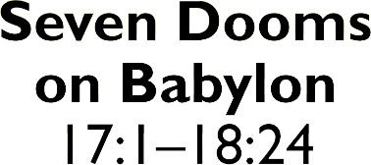
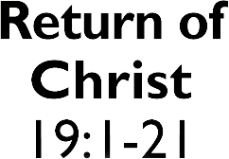
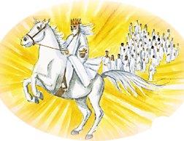
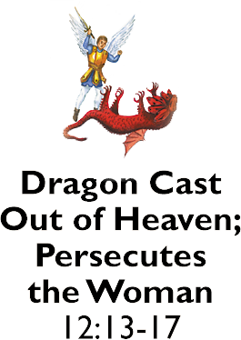
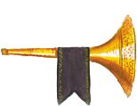
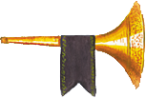
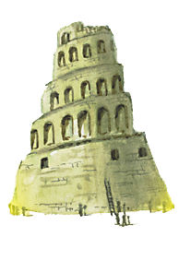
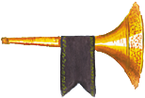
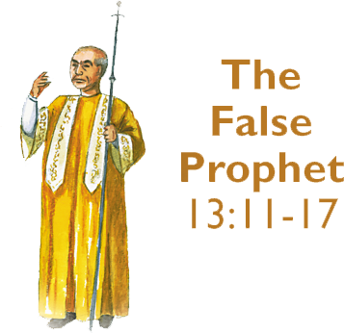
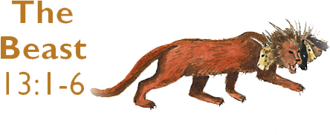

Slide 3
The saints of Israel.
Harm is withheld from those sealed.
The sealed are clearly of Israel.
The list is different and we don’t know why.

Slide 4
The gentile saints.
The saints lead in worship.
They are clothed in white robes,
carrying palm branches,
and worshipping God.
The hosts of heaven join their worship.

Slide 5
The gentile saints.
The martyrs are consoled.
They are in the presence of God.
They are physically secure.
They are emotionally secure.

Slide 6
What does that mean to me?

Slide 7
God is not done with Israel yet.
We must support Israel.
We must pray for Israel!

Slide 8
Worship God!
Worship Him with the gospel.
Worship Him with faithfulness.
Worship Him with truth.
Worship Him with your life!

Slide 9
God will comfort our trials.
God’s presence is our desire.
He will make us wholly secure.

