Slide 2
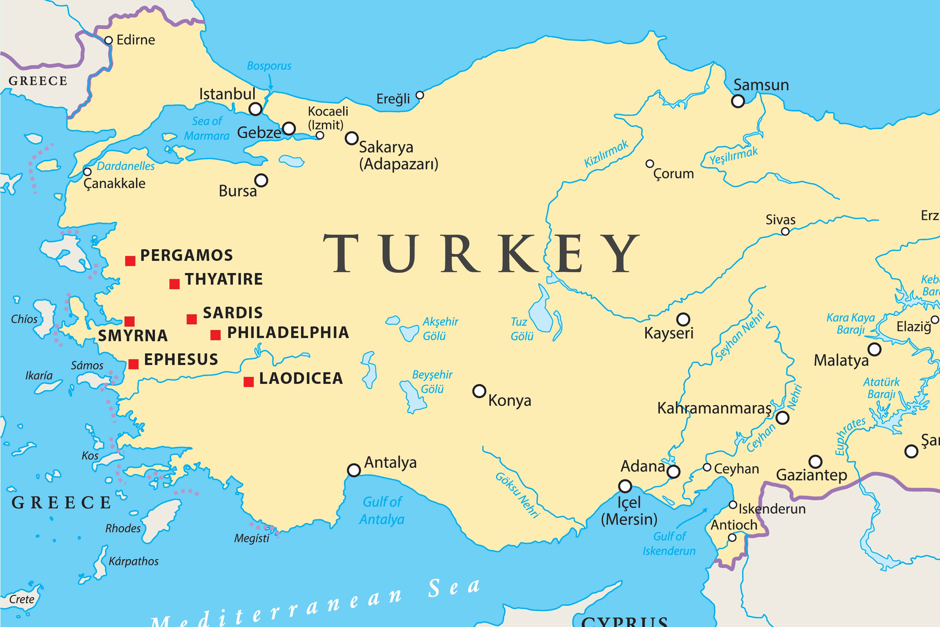

Slide 3
The Church of

Slide 4
The significant introduction

Slide 5
They were doctrinally pure

Slide 6
Their love had worn off

Slide 7
The first of the rewards

Slide 8
How does that apply to me?

Slide 9
Jesus has the ultimate authority over His church!

Slide 10
Jesus knows our situations and actions!

Slide 11
We must defend the faith adamantly and accurately!

Slide 12
Love God first! Never let it wear off!

Slide 13
Reenergize your love with your works!

Slide 14
God faithfully rewards your faith!

