Slide 2
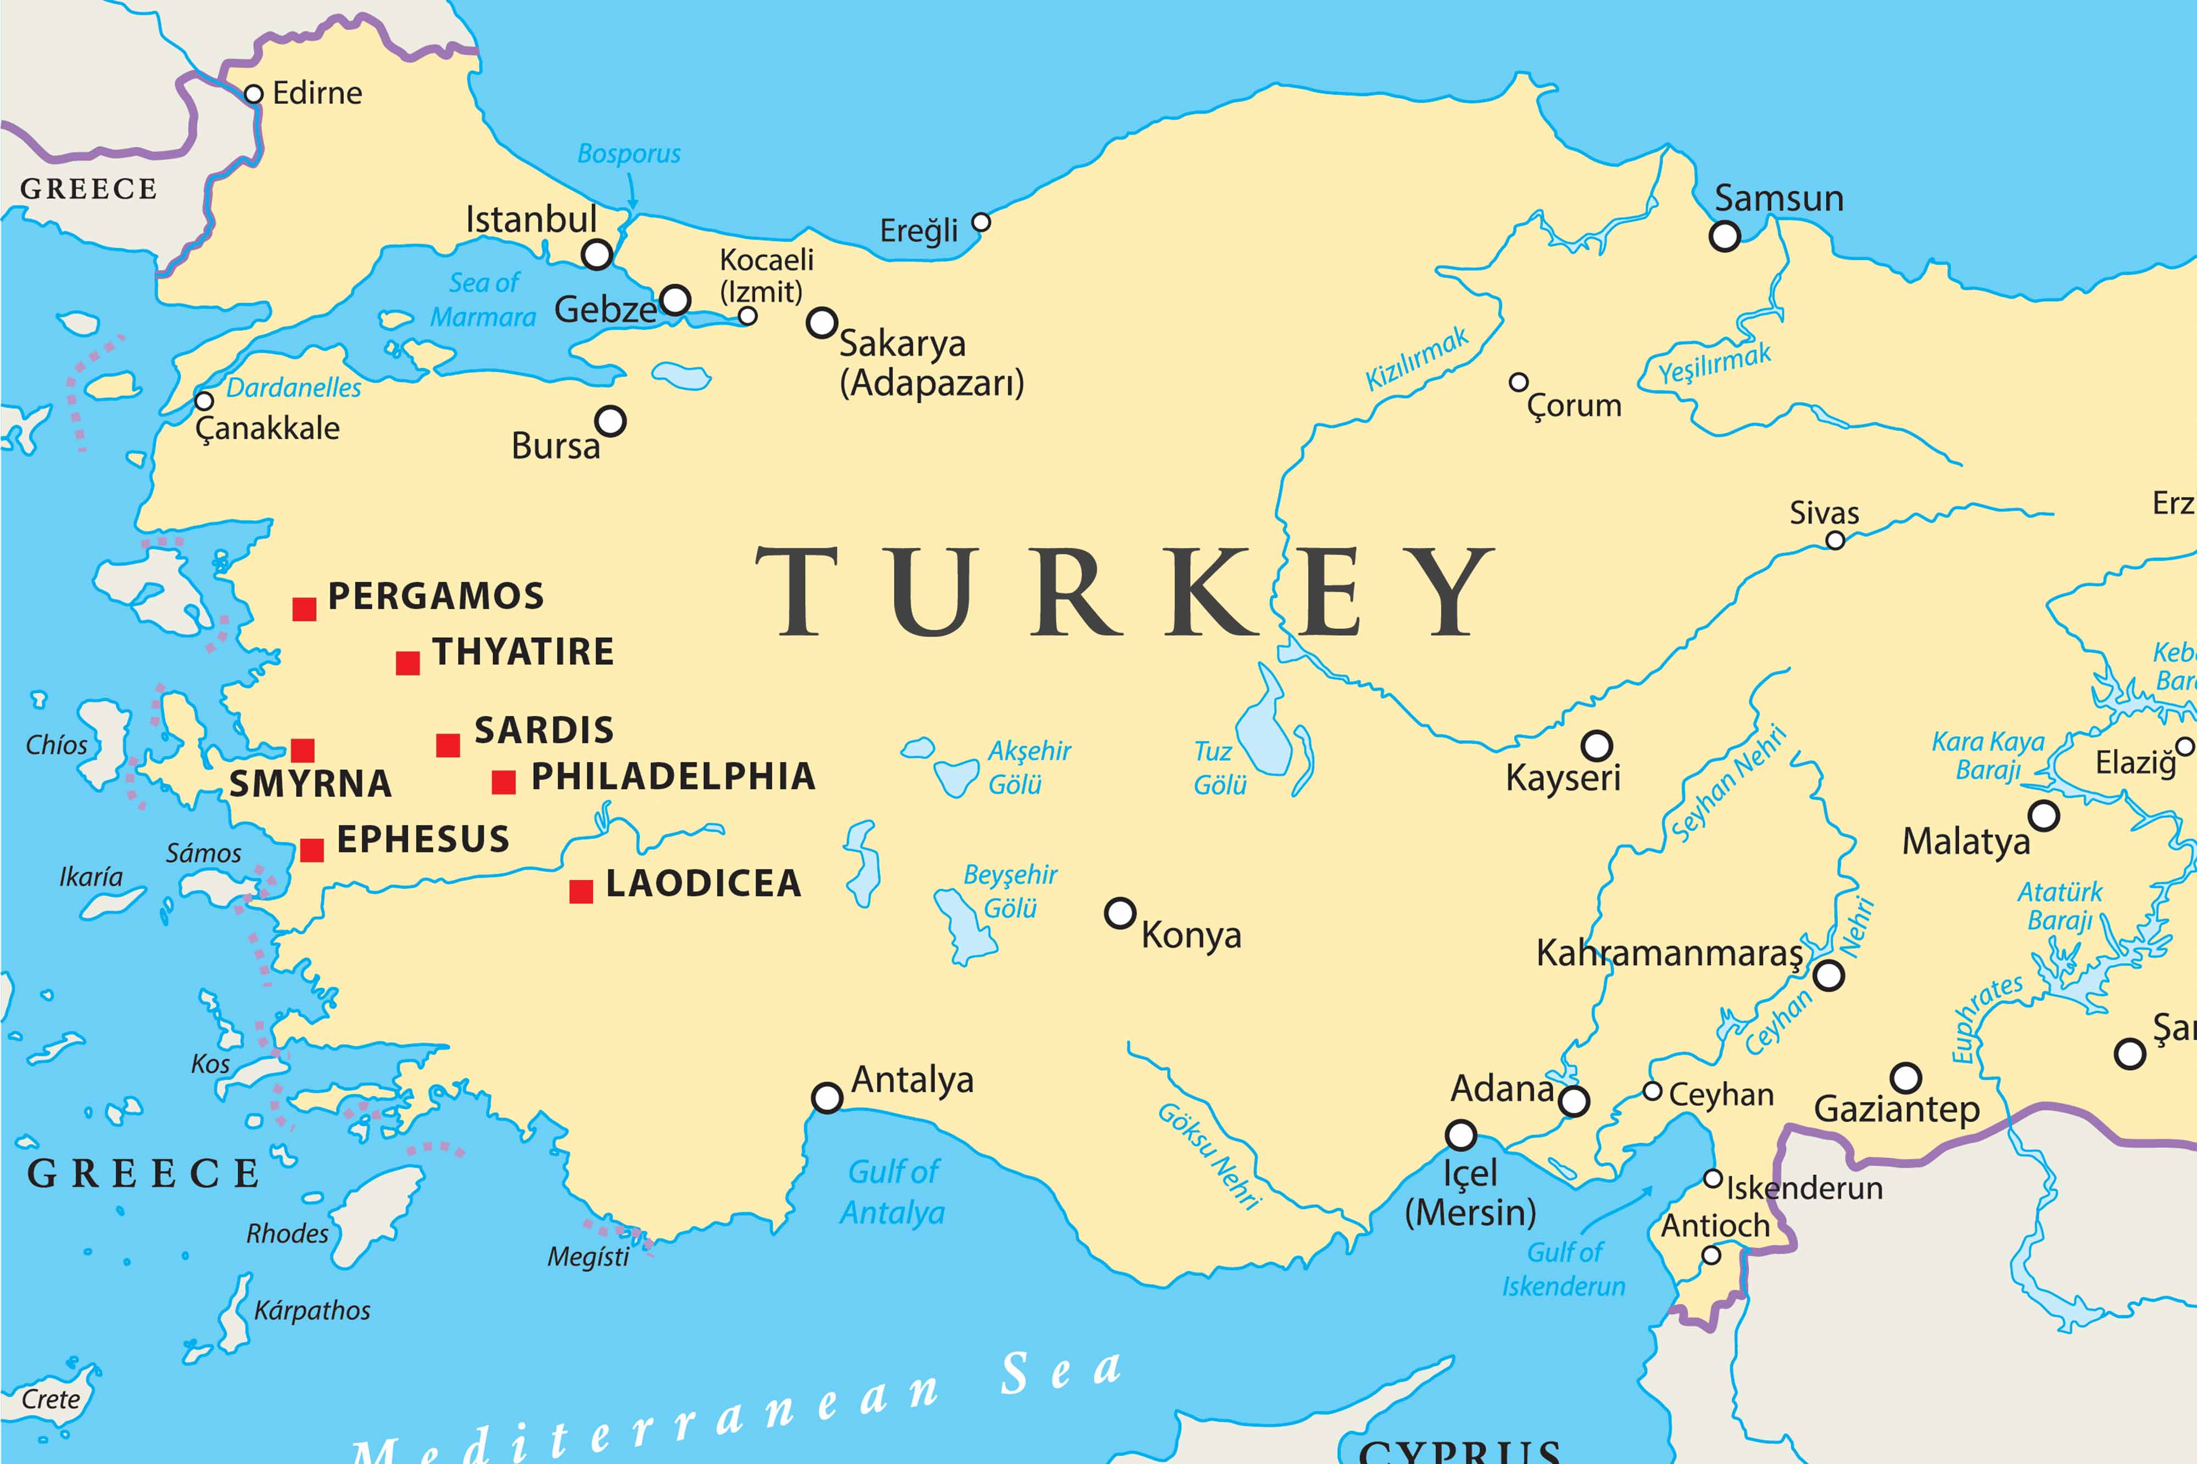

Slide 3
The Church of

Slide 4
The glowing introduction

Slide 5
A massive problem

Slide 6
The faithful remnant

Slide 7
The fourth reward

Slide 8
How does that apply to me?

Slide 9
Jesus sees! You cannot hide anything from Him!

Slide 10
Guard yourself from attractive false teaching!

Slide 11
Repent of your sin!

Slide 12
Leading others is a serious thing. Be extra careful!

Slide 13
Jesus is the ultimate relationship!

